Slide 1
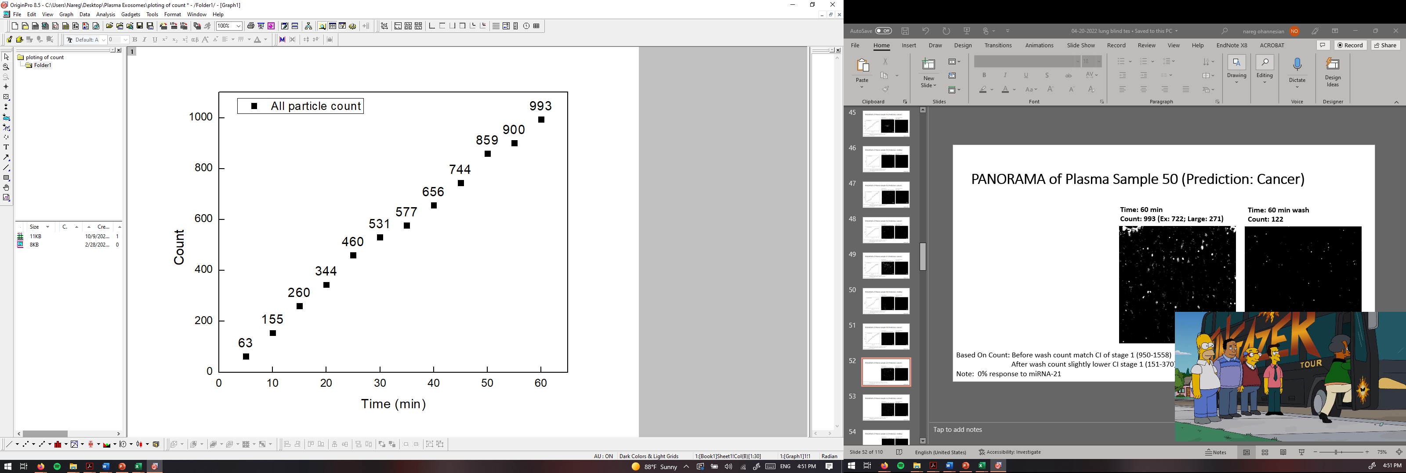
PANORAMA of Plasma Sample 50 (Prediction: Cancer)
Time: 60 min
Count: 993 (Ex: 722; Large: 271)
Time: 60 min wash
Count: 122
Based On Count: Before wash count match CI of stage 1 (950-1558)
After wash count slightly lower CI stage 1 (151-370)
Note: 0% response to miRNA-21
Scale bar: 10 µm

Slide 2
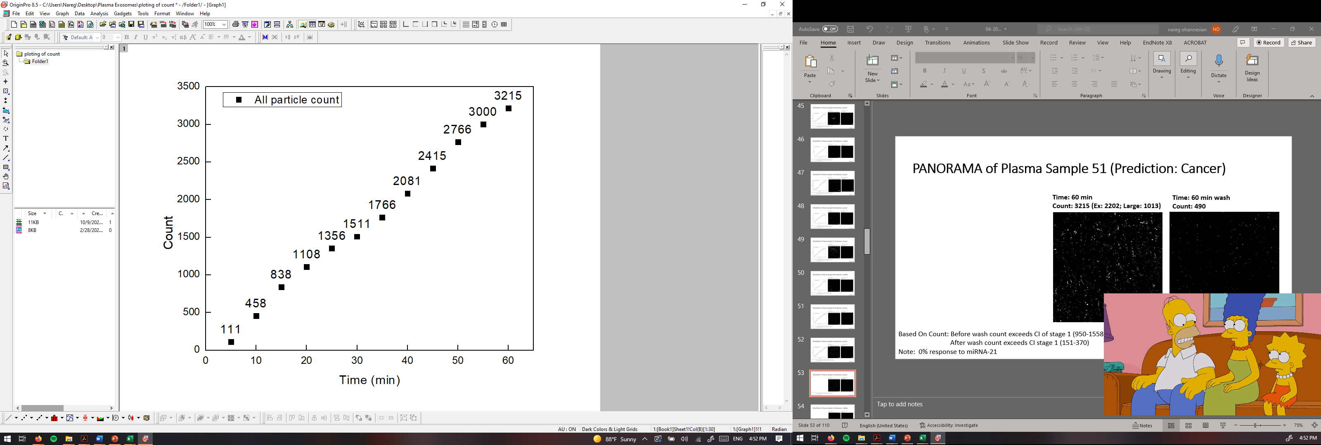
PANORAMA of Plasma Sample 51 (Prediction: Cancer)
Time: 60 min
Count: 3215 (Ex: 2202; Large: 1013)
Time: 60 min wash
Count: 490
Based On Count: Before wash count exceeds CI of stage 1 (950-1558)
After wash count exceeds CI stage 1 (151-370)
Note: 0% response to miRNA-21
Scale bar: 10 µm

Slide 3
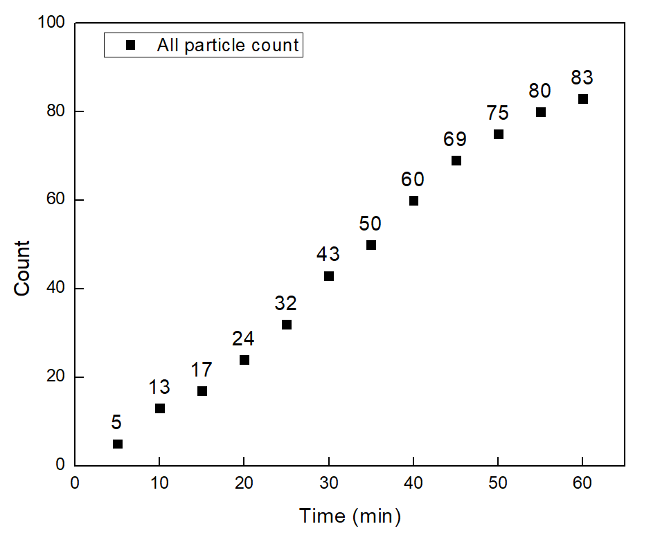


PANORAMA of Plasma Sample 52 (Prediction: Healthy)
Time: 60 min
Count: 83 (Ex: 73; Large: 10)
Time: 60 min wash
Count: 37
Based On Count: Before wash count match CI Healthy (214-263)
After wash count lower CI Healthy (24-34)
Note: 0 % response to miRNA-21
Scale bar: 10 µm

Slide 4
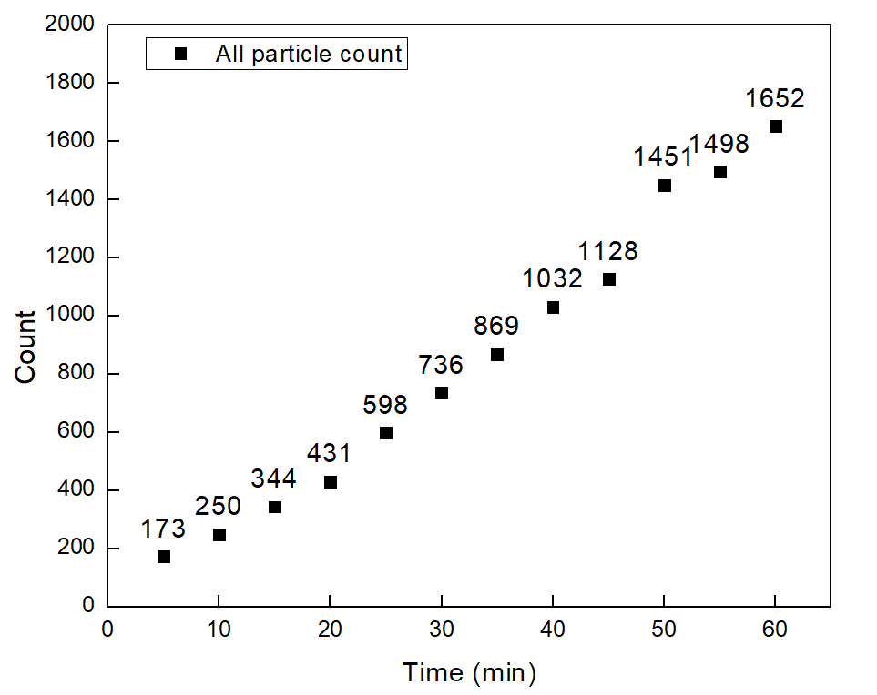


PANORAMA of Plasma Sample 53 (Prediction: Cancer)
Time: 60 min
Count: 1652 (Ex: 920; Large: 732)
Time: 60 min wash
Count: 470
Based On Count: Before wash count exceeds CI of stage 1 (950-1558)
After wash count exceeds CI stage 1 (151-370)
Note: 0% response to miRNA-21
Scale bar: 10 µm

Slide 5
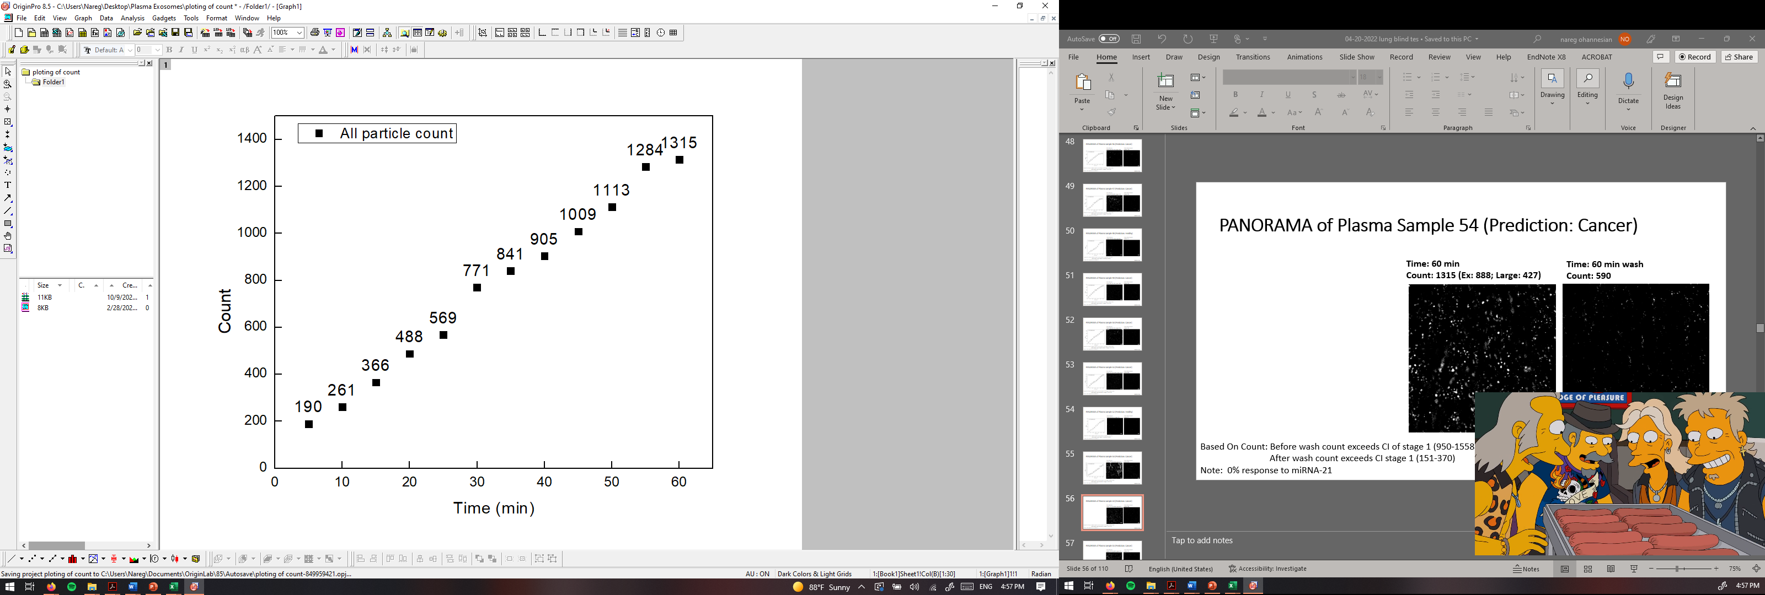
PANORAMA of Plasma Sample 54 (Prediction: Cancer)
Time: 60 min
Count: 1315 (Ex: 888; Large: 427)
Time: 60 min wash
Count: 590
Based On Count: Before wash count exceeds CI of stage 1 (950-1558)
After wash count exceeds CI stage 1 (151-370)
Note: 0% response to miRNA-21
Scale bar: 10 µm

Slide 6
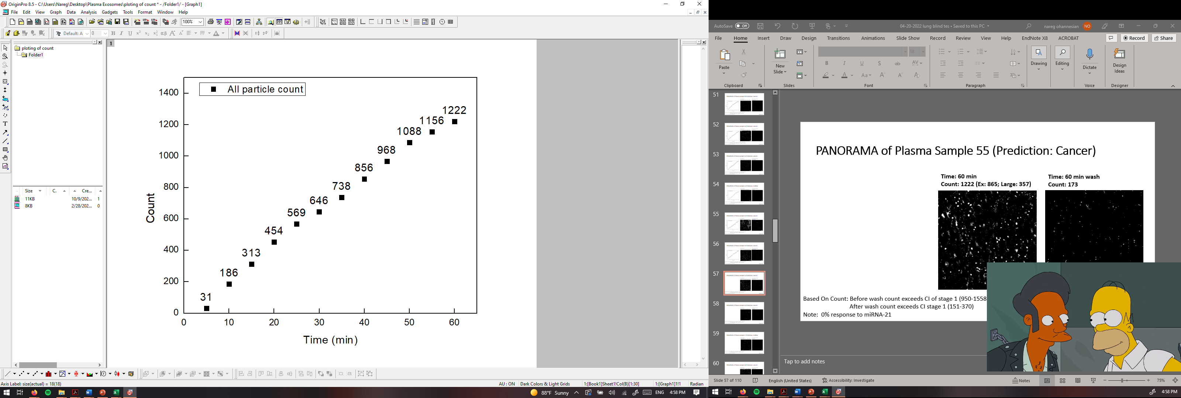

PANORAMA of Plasma Sample 55 (Prediction: Cancer)
Time: 60 min
Count: 1222 (Ex: 865; Large: 357)
Time: 60 min wash
Count: 173
Based On Count: Before wash count exceeds CI of stage 1 (950-1558)
After wash count exceeds CI stage 1 (151-370)
Note: 0% response to miRNA-21
Scale bar: 10 µm

Slide 7
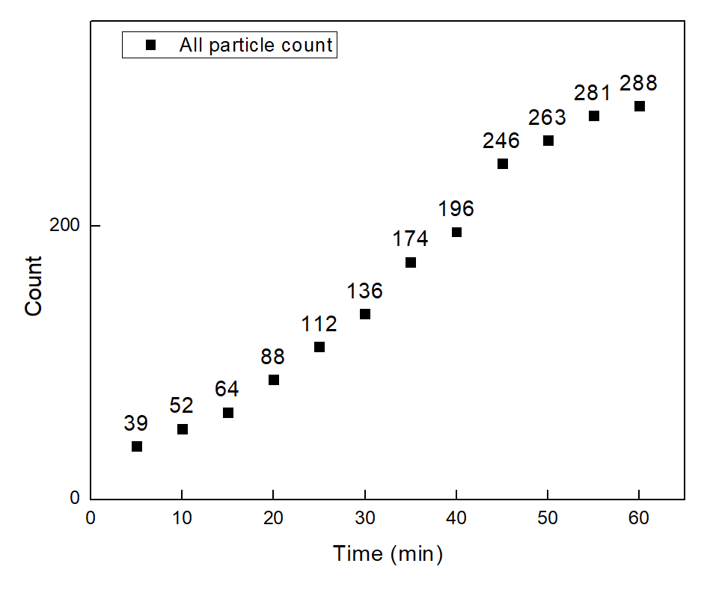
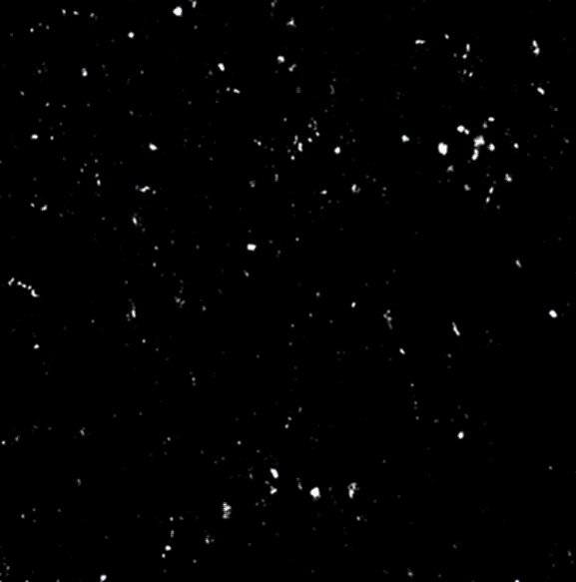

PANORAMA of Plasma Sample 56 (Prediction: Cancer)
Time: 60 min
Count: 288 (Ex: 218; Large: 70)
Time: 60 min wash
Count: 97
Based On Count: Before wash count Lower CI of stage 1 (950-1558)
After wash count Lower CI stage 1 (151-370)
Note: 0% response to miRNA-21
Scale bar: 10 µm

Slide 8
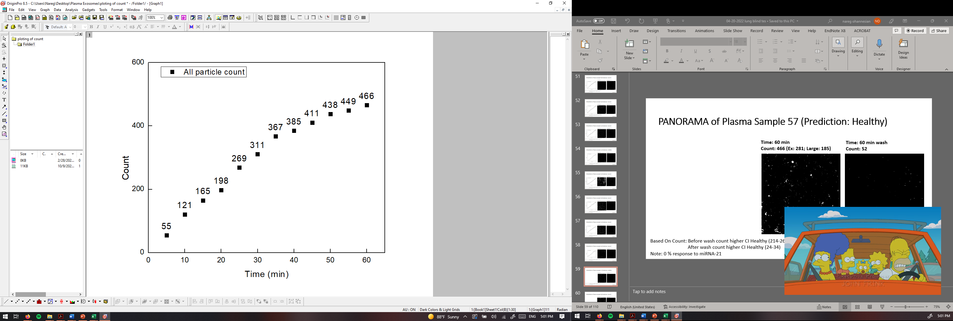

PANORAMA of Plasma Sample 57 (Prediction: Healthy)
Time: 60 min
Count: 466 (Ex: 281; Large: 185)
Time: 60 min wash
Count: 52
Based On Count: Before wash count higher CI Healthy (214-263)
After wash count higher CI Healthy (24-34)
Note: 0 % response to miRNA-21
Scale bar: 10 µm

Slide 9
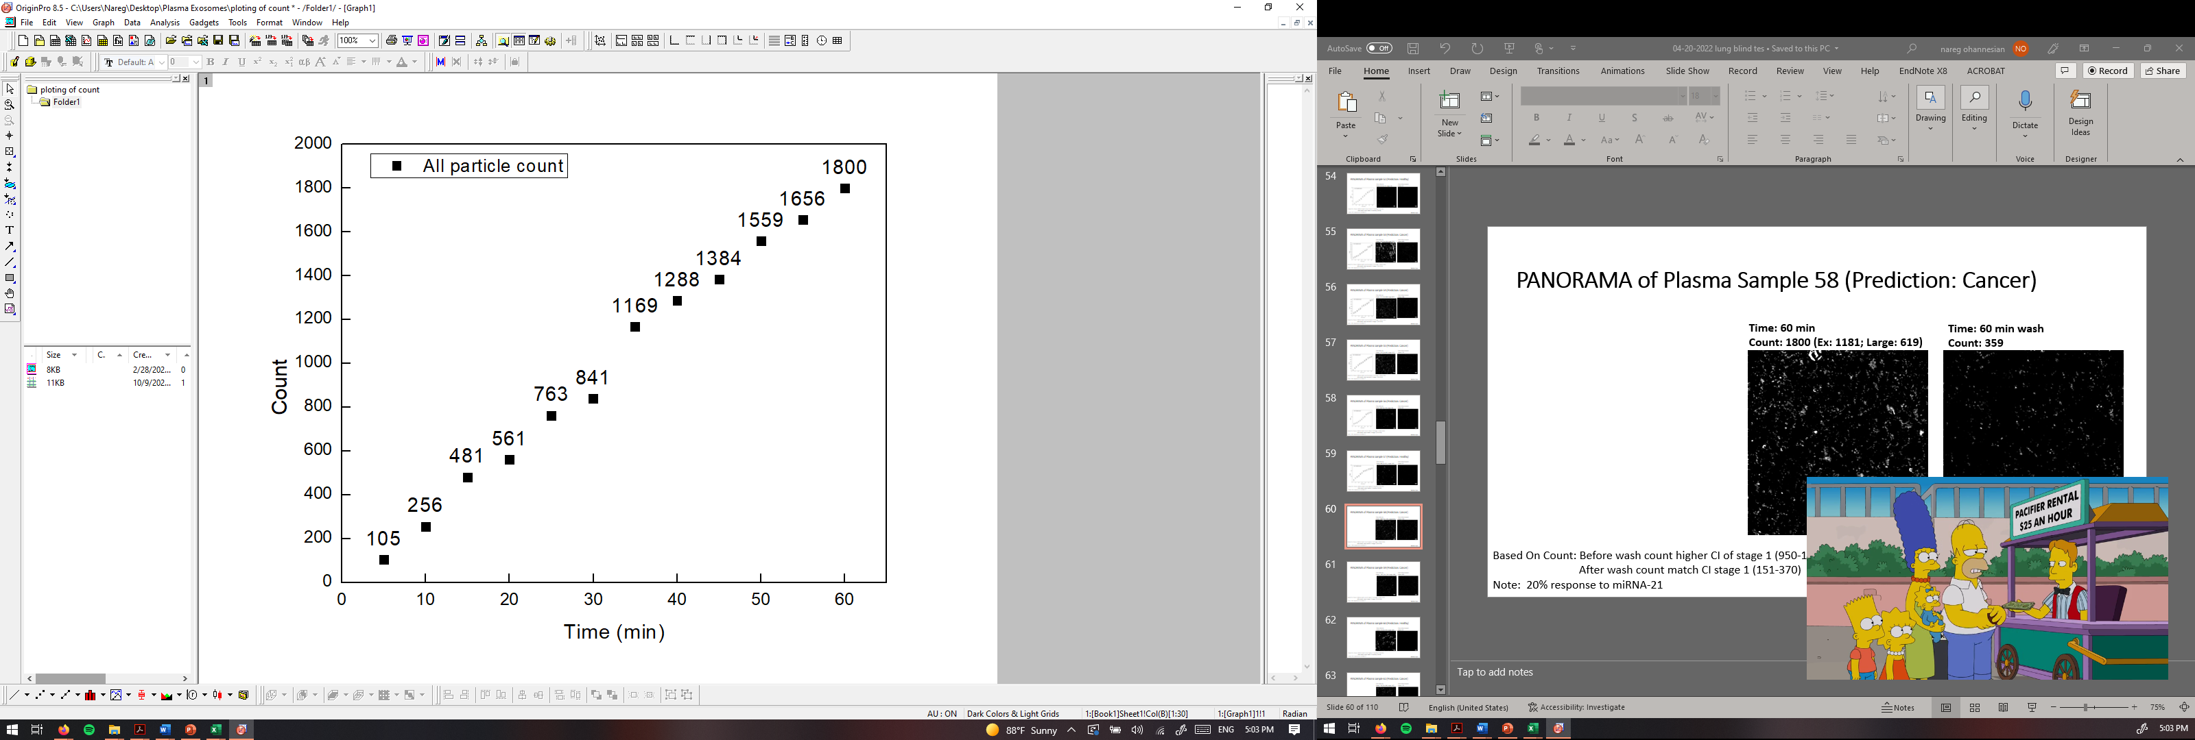
PANORAMA of Plasma Sample 58 (Prediction: Cancer)
Time: 60 min
Count: 1800 (Ex: 1181; Large: 619)
Time: 60 min wash
Count: 359
Based On Count: Before wash count higher CI of stage 1 (950-1558)
After wash count match CI stage 1 (151-370)
Note: 20% response to miRNA-21
Scale bar: 10 µm

Slide 10
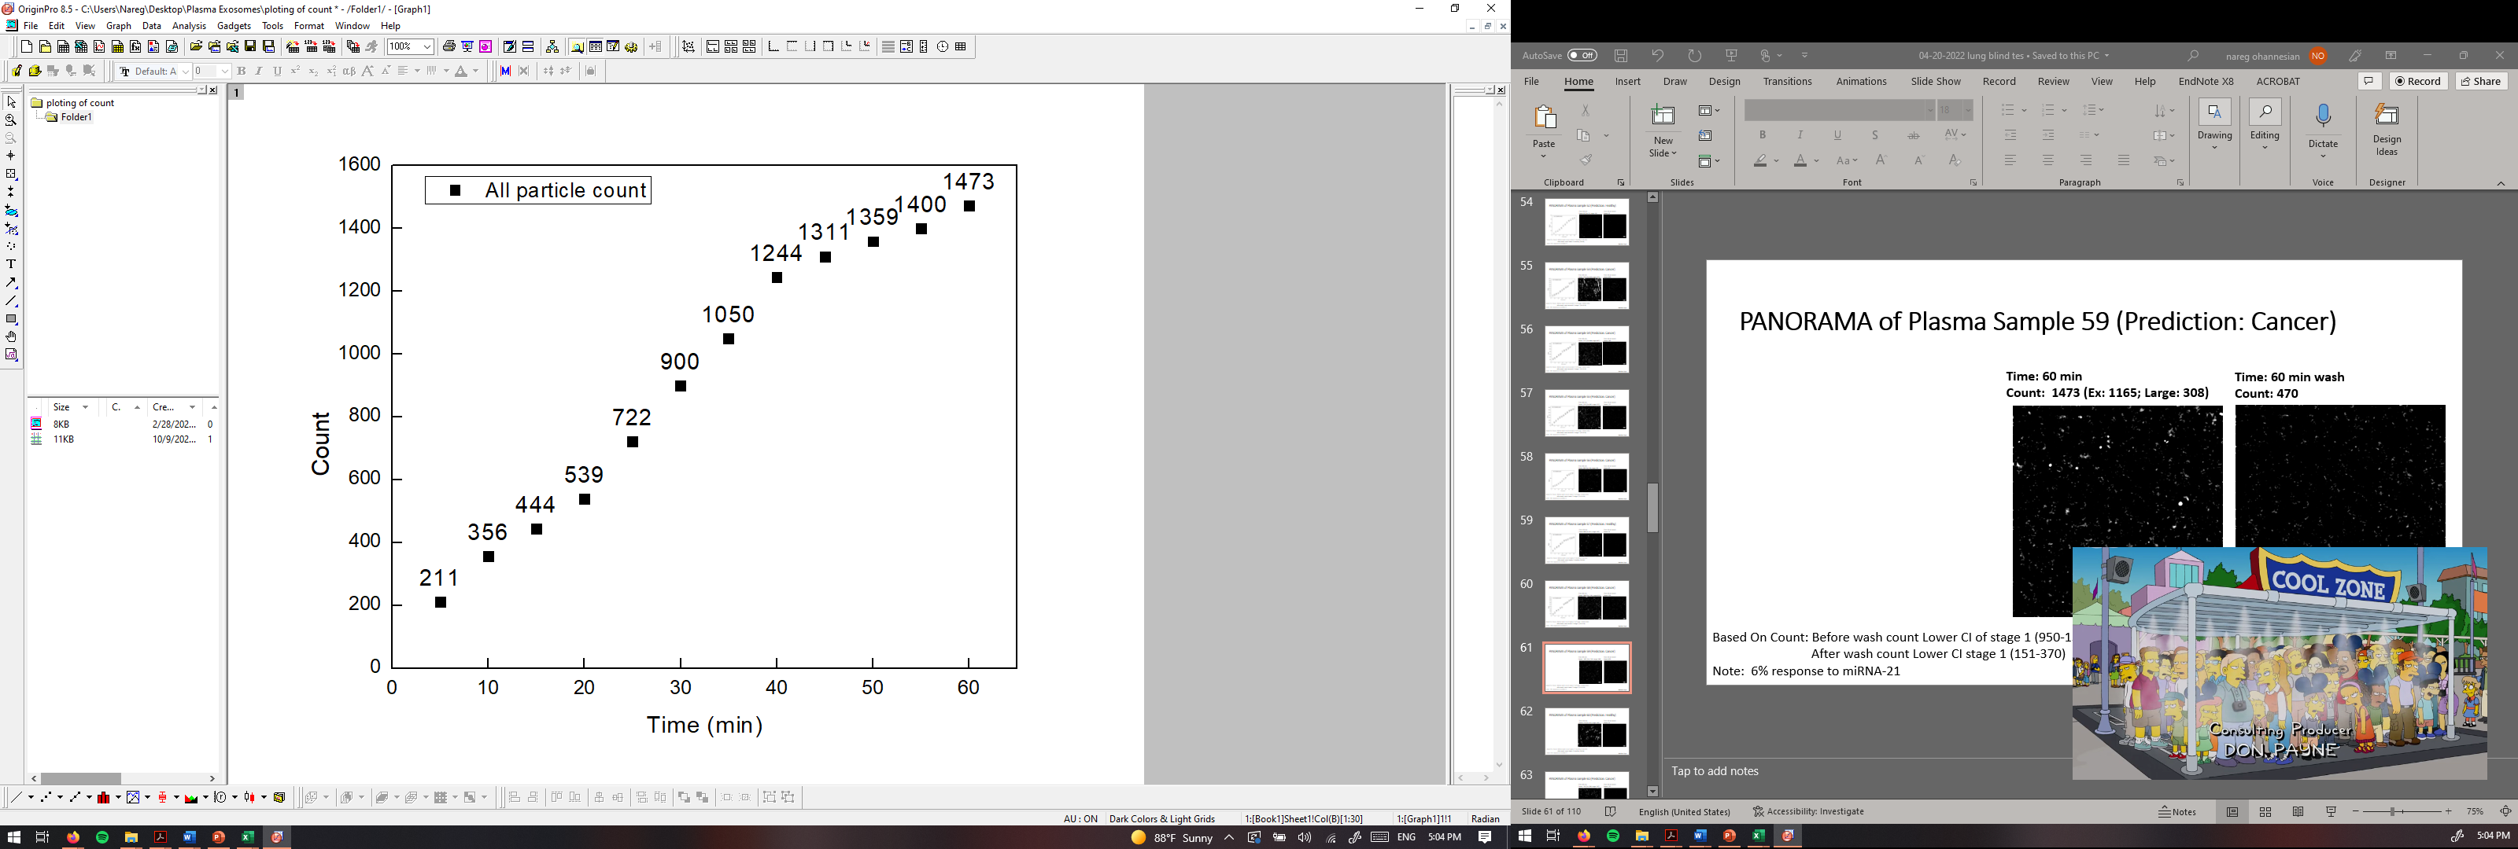
PANORAMA of Plasma Sample 59 (Prediction: Cancer)
Time: 60 min
Count: 1473 (Ex: 1165; Large: 308)
Time: 60 min wash
Count: 470
Based On Count: Before wash count Lower CI of stage 1 (950-1558)
After wash count Lower CI stage 1 (151-370)
Note: 6% response to miRNA-21
Scale bar: 10 µm

Slide 11
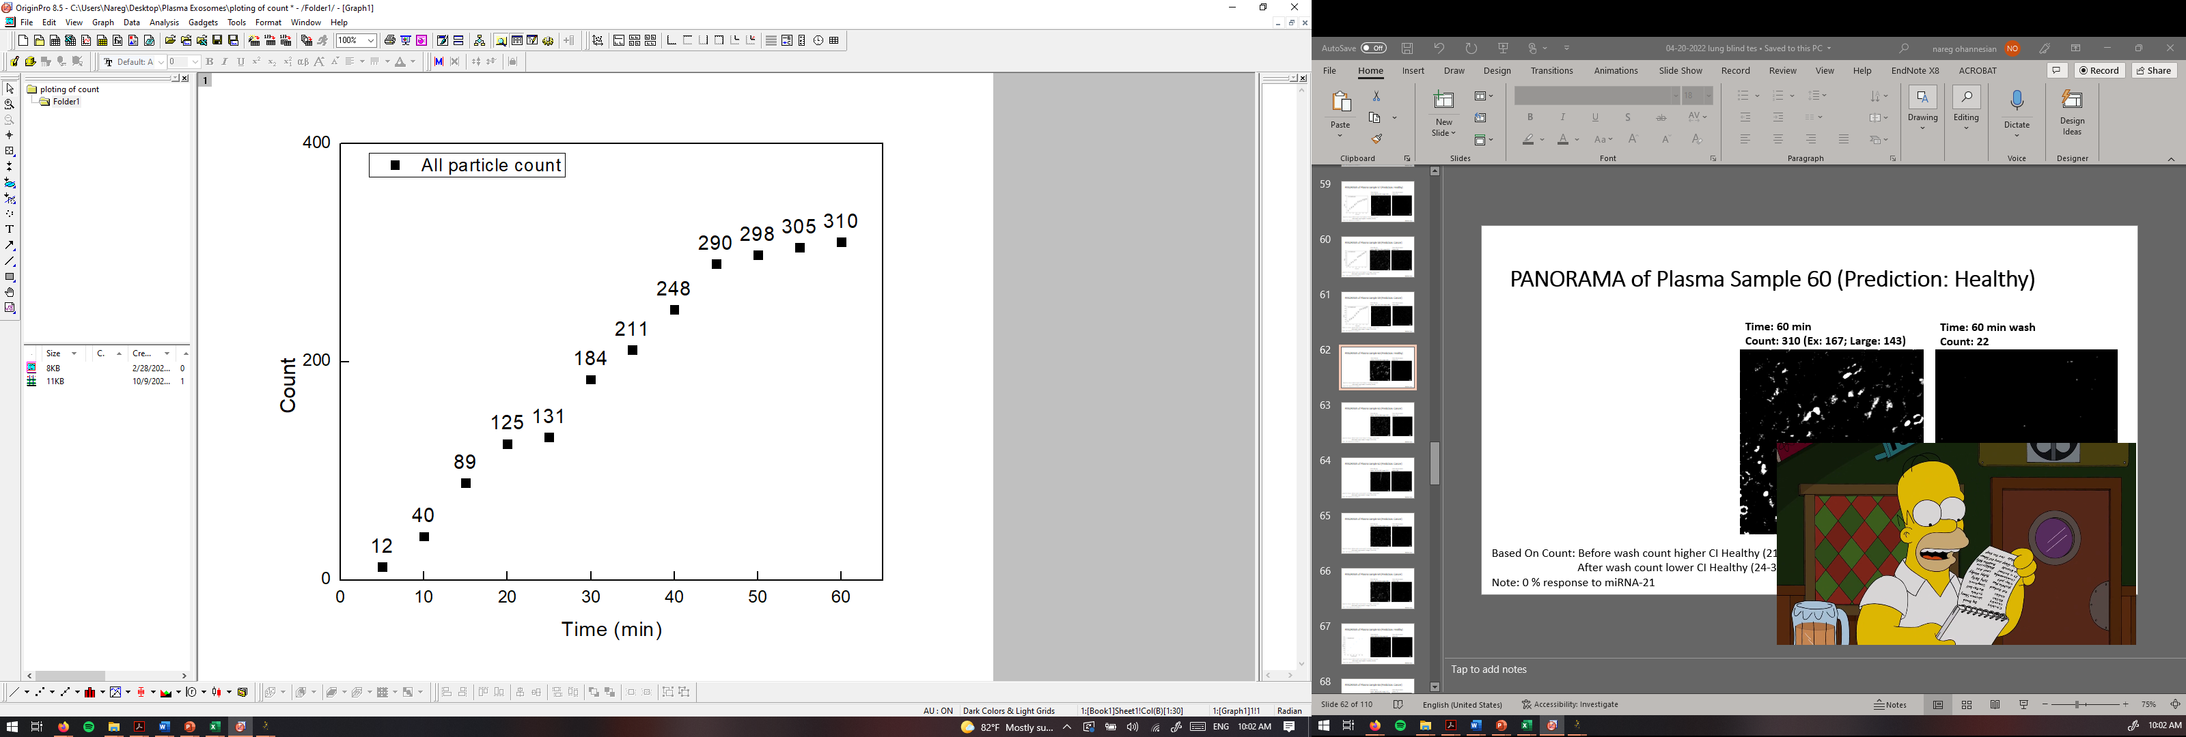
PANORAMA of Plasma Sample 60 (Prediction: Healthy)
Time: 60 min
Count: 310 (Ex: 167; Large: 143)
Time: 60 min wash
Count: 22
Based On Count: Before wash count higher CI Healthy (214-263)
After wash count lower CI Healthy (24-34)
Note: 0 % response to miRNA-21
Scale bar: 10 µm

Slide 12
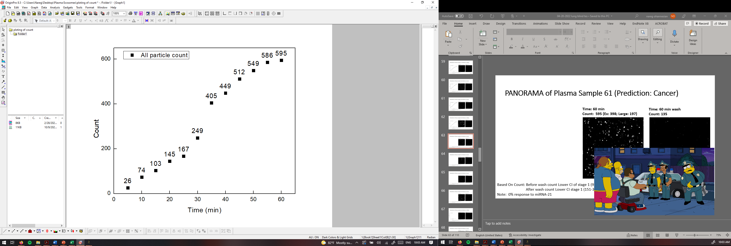
PANORAMA of Plasma Sample 61 (Prediction: Cancer)
Time: 60 min
Count: 595 (Ex: 398; Large: 197)
Time: 60 min wash
Count: 135
Based On Count: Before wash count Lower CI of stage 1 (950-1558)
After wash count Lower CI stage 1 (151-370)
Note: 0% response to miRNA-21
Scale bar: 10 µm

Slide 13
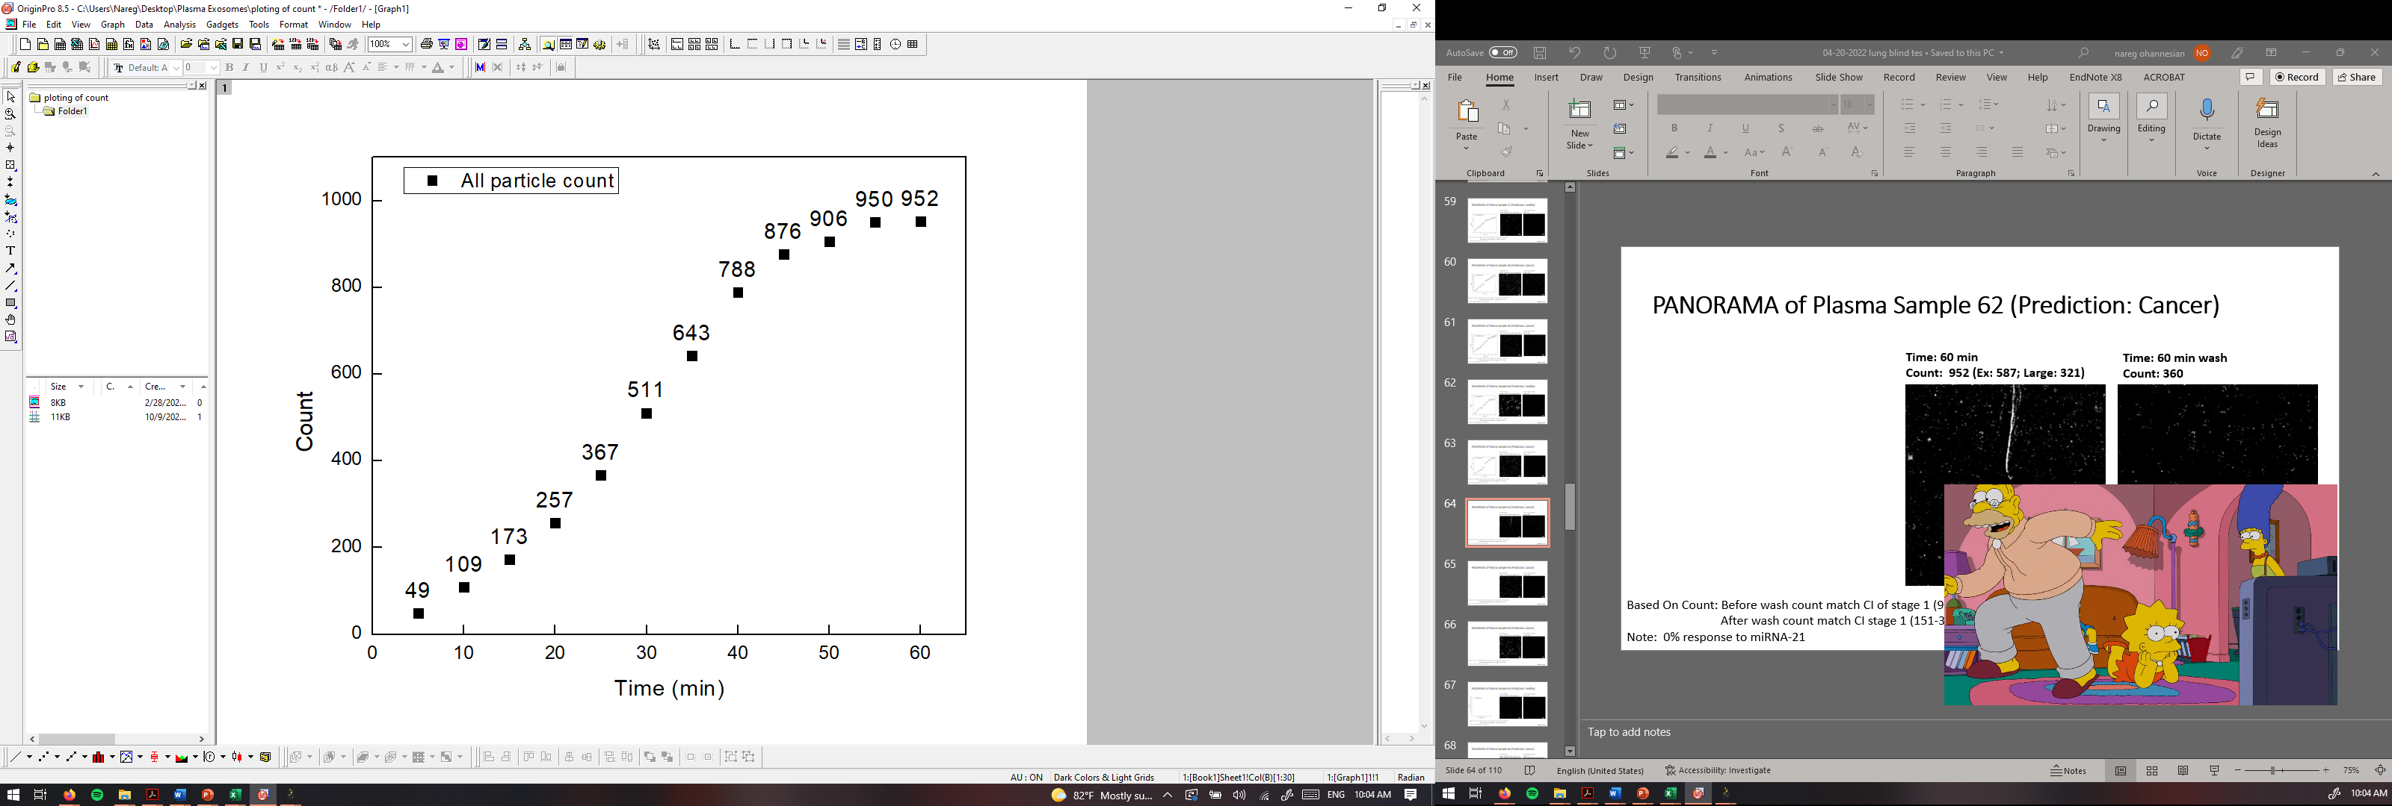
PANORAMA of Plasma Sample 62 (Prediction: Cancer)
Time: 60 min
Count: 952 (Ex: 587; Large: 321)
Time: 60 min wash
Count: 360
Based On Count: Before wash count match CI of stage 1 (950-1558)
After wash count match CI stage 1 (151-370)
Note: 0% response to miRNA-21
Scale bar: 10 µm

Slide 14
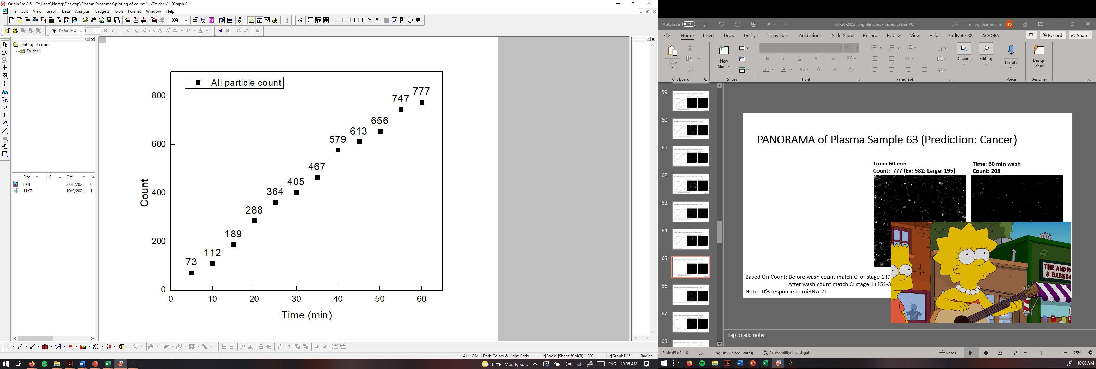

PANORAMA of Plasma Sample 63 (Prediction: Cancer)
Time: 60 min
Count: 777 (Ex: 582; Large: 195)
Time: 60 min wash
Count: 208
Based On Count: Before wash count match CI of stage 1 (950-1558)
After wash count match CI stage 1 (151-370)
Note: 0% response to miRNA-21
Scale bar: 10 µm

Slide 15
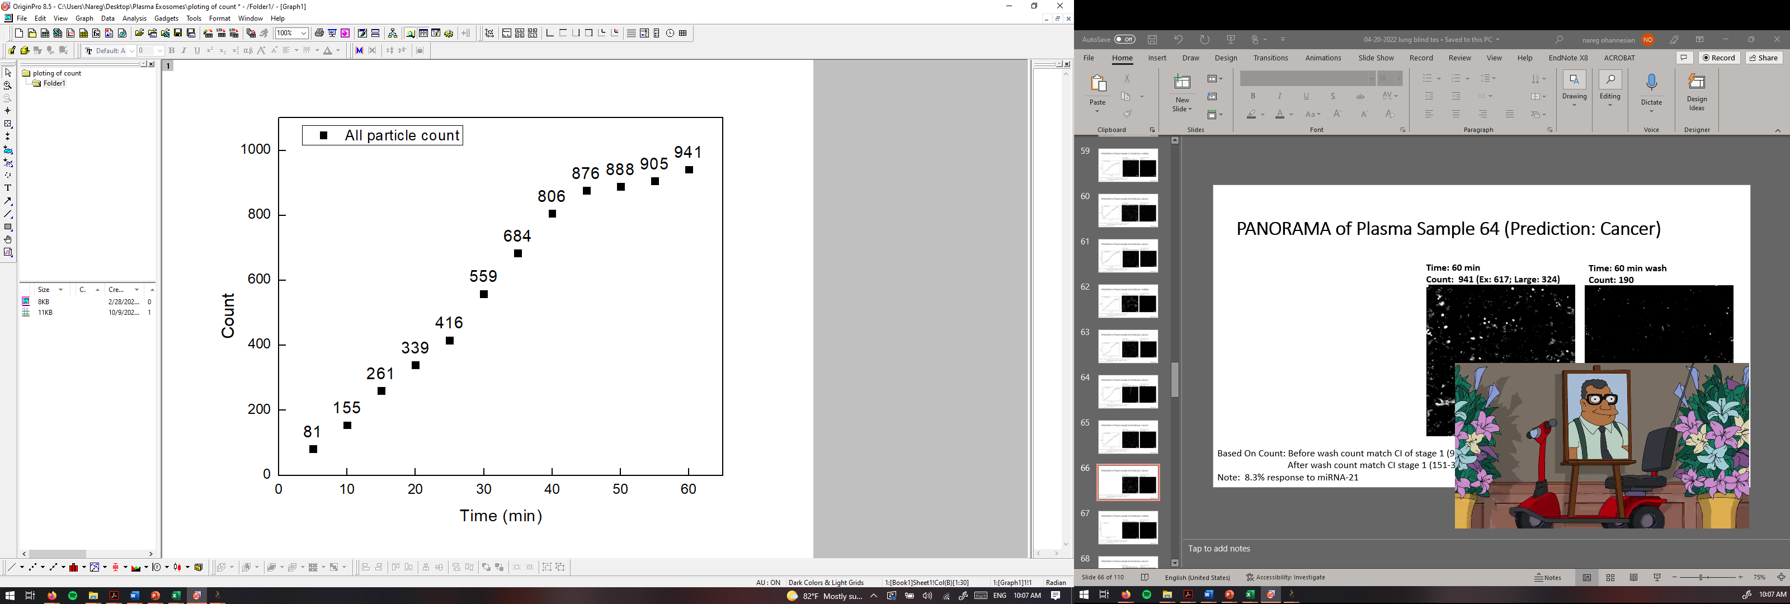
PANORAMA of Plasma Sample 64 (Prediction: Cancer)
Time: 60 min
Count: 941 (Ex: 617; Large: 324)
Time: 60 min wash
Count: 190
Based On Count: Before wash count match CI of stage 1 (950-1558)
After wash count match CI stage 1 (151-370)
Note: 8.3% response to miRNA-21
Scale bar: 10 µm

Slide 16
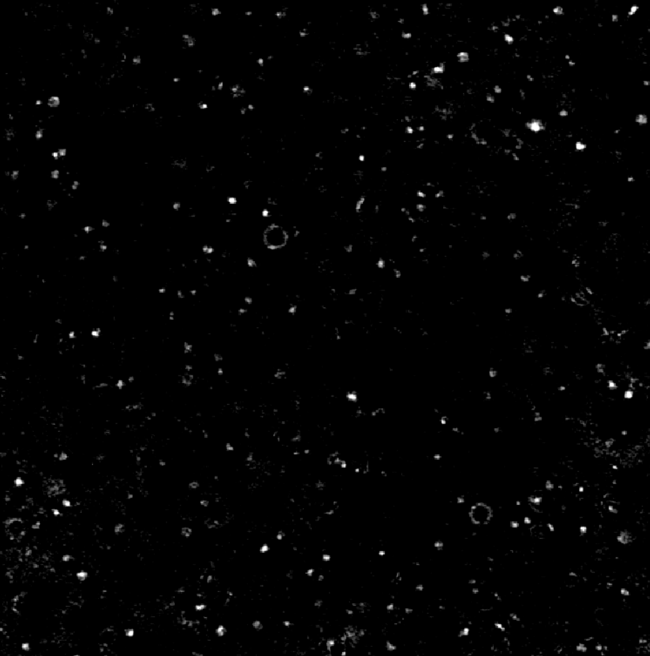

PANORAMA of Plasma Sample 65 (Prediction: Healthy)
Time: 60 min
Count: 406 (Ex: 314; Large: 92)
Time: 60 min wash
Count: 61
Based On Count: Before wash count higher CI Healthy (214-263)
After wash count higher CI Healthy (24-34)
Note: 0 % response to miRNA-21
Scale bar: 10 µm

Slide 17
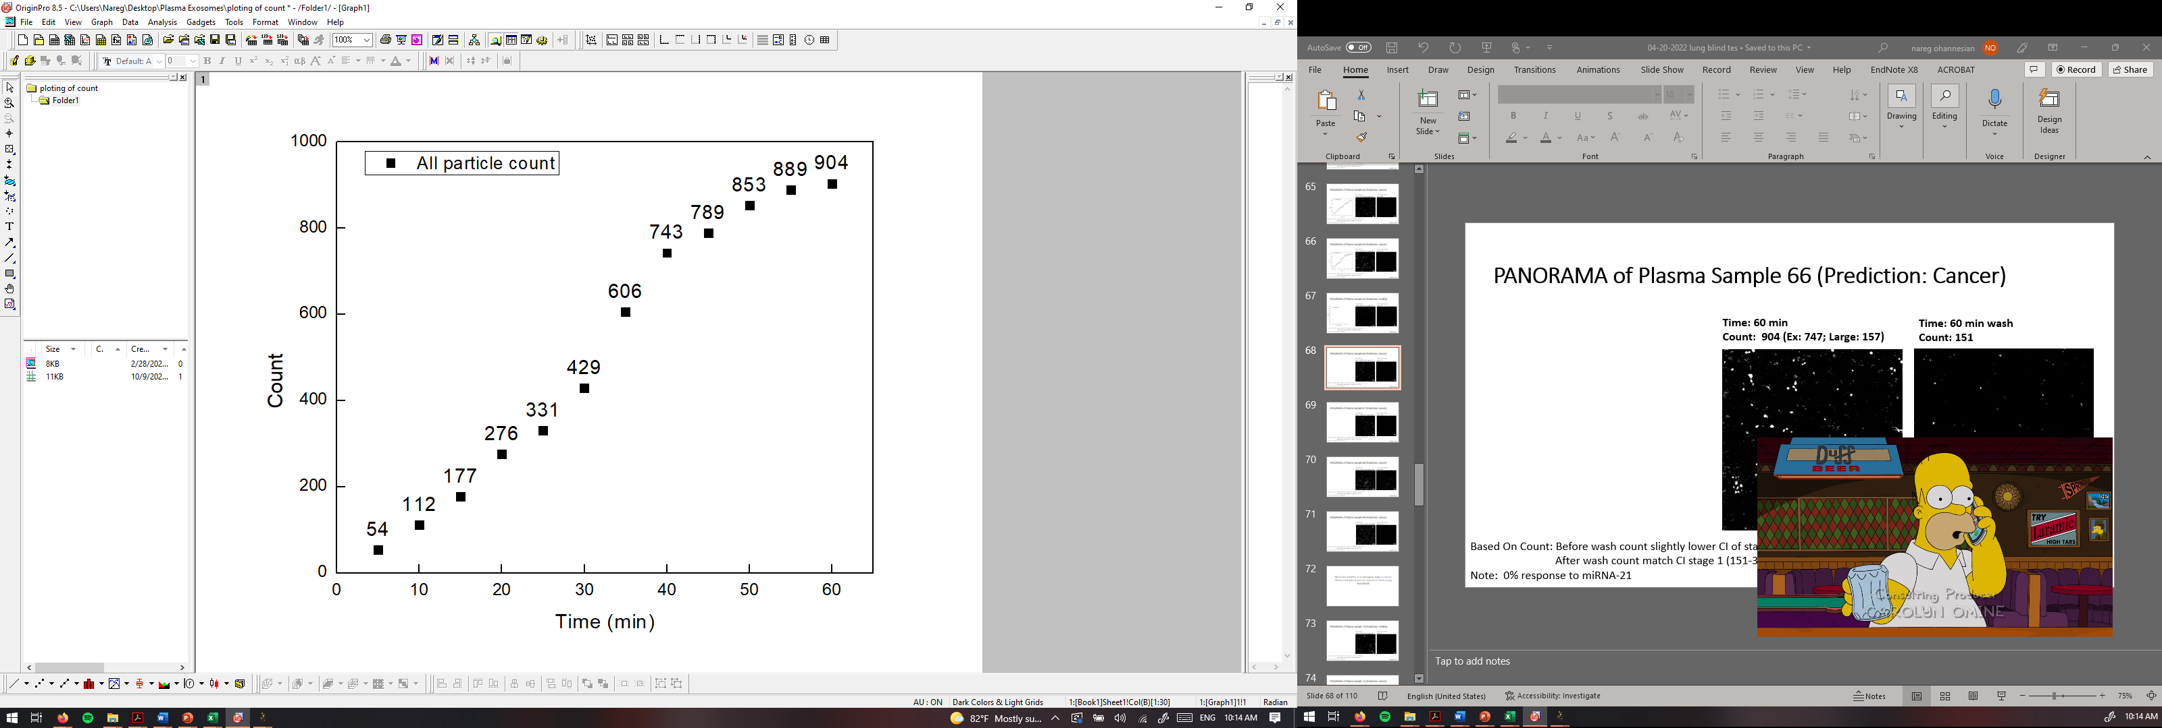
PANORAMA of Plasma Sample 66 (Prediction: Cancer)
Time: 60 min
Count: 904 (Ex: 747; Large: 157)
Time: 60 min wash
Count: 151
Based On Count: Before wash count slightly lower CI of stage 1 (950-1558)
After wash count match CI stage 1 (151-370)
Note: 0% response to miRNA-21
Scale bar: 10 µm

Slide 18
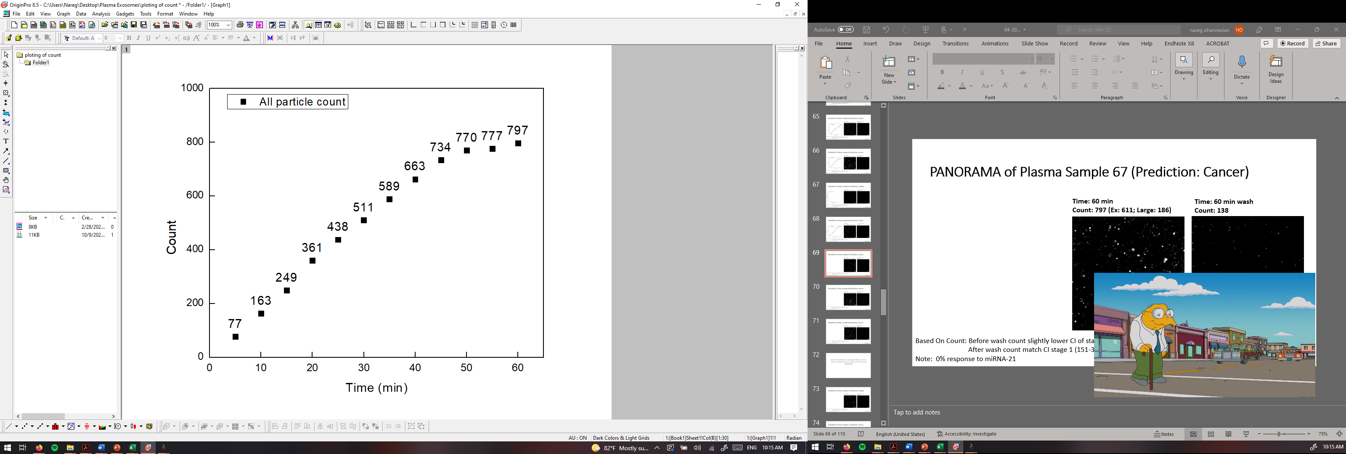
PANORAMA of Plasma Sample 67 (Prediction: Cancer)
Time: 60 min
Count: 797 (Ex: 611; Large: 186)
Time: 60 min wash
Count: 138
Based On Count: Before wash count slightly lower CI of stage 1 (950-1558)
After wash count match CI stage 1 (151-370)
Note: 0% response to miRNA-21
Scale bar: 10 µm

Slide 19
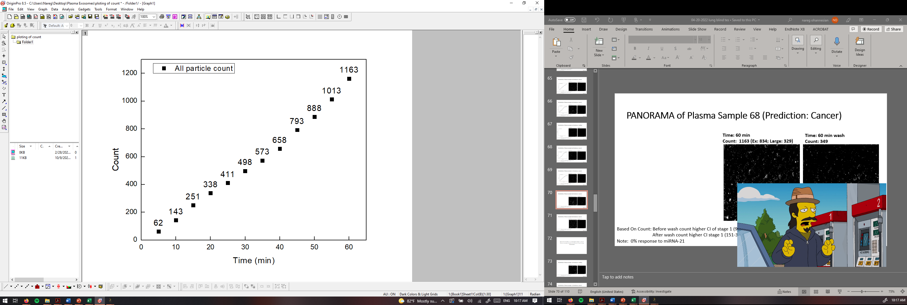
PANORAMA of Plasma Sample 68 (Prediction: Cancer)
Time: 60 min
Count: 1163 (Ex: 834; Large: 329)
Time: 60 min wash
Count: 349
Based On Count: Before wash count higher CI of stage 1 (950-1558)
After wash count higher CI stage 1 (151-370)
Note: 0% response to miRNA-21
Scale bar: 10 µm

Slide 20
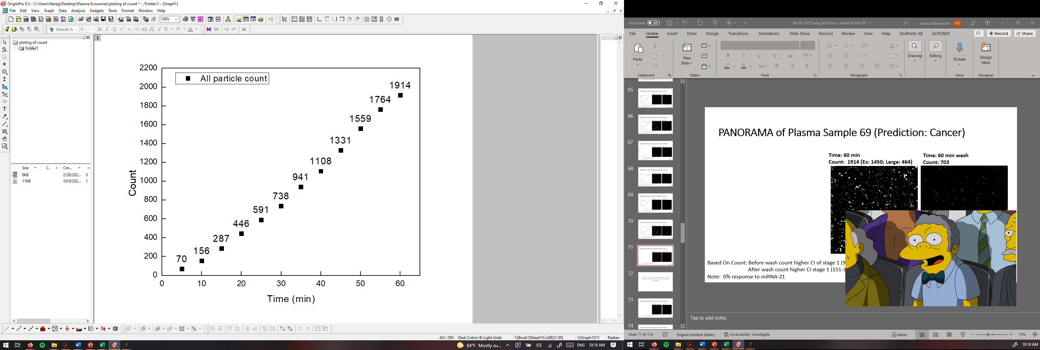

PANORAMA of Plasma Sample 69 (Prediction: Cancer)
Time: 60 min
Count: 1914 (Ex: 1450; Large: 464)
Time: 60 min wash
Count: 703
Based On Count: Before wash count higher CI of stage 1 (950-1558)
After wash count higher CI stage 1 (151-370)
Note: 0% response to miRNA-21
Scale bar: 10 µm

Slide 21
Number | Total | Large | Exosome | Retained | MIR-21 | Prediction | State | Sample
1 | 1866 | 292 | 1574 | 925 | 0 | Cancer | Cancer | 92A
2 | 1402 | 223 | 1179 | 611 | 0 | Cancer | Cancer | 137A
3 | 924 | 330 | 594 | 272 | 0 | Cancer | Cancer | 86A
4 | 18 | 8 | 10 | 4 | 0 | Healthy | Healthy | HCR 158
5 | 894 | 218 | 676 | 157 | 0 | Cancer | Cancer | 103A
6 | 1244 | 336 | 908 | 204 | 0 | Cancer | Cancer | 133A
7 | 251 | 53 | 198 | 60 | 0 | Healthy | Healthy | HCR 140
8 | 563 | 160 | 403 | 229 | 0 | Cancer | Cancer | 83A
9 | 74 | 13 | 61 | 17 | 0 | Healthy | Healthy | HCR 160
10 | 749 | 296 | 453 | 266 | 0 | Cancer | Cancer | 7A
11 | 602 | 117 | 485 | 97 | 0 | Cancer | Cancer | 170A
12 | 412 | 152 | 260 | 93 | 0 | Cancer | Cancer | 139A
13 | 89 | 33 | 56 | 29 | 0 | Healthy | Healthy | HCR 92
14 | 645 | 115 | 530 | 237 | 8 | Cancer | Cancer | 102A
15 | 675 | 138 | 537 | 230 | 0 | Cancer | Cancer | 140A
16 | 397 | 146 | 251 | 9 | 0 | Healthy | Healthy | HCR 153
17 | 825 | 313 | 512 | 178 | 0 | Cancer | Cancer | 129A
18 | 988 | 524 | 563 | 151 | 0 | Cancer | Cancer | 224A
19 | 81 | 5 | 76 | 10 | 0 | Healthy | Healthy | HCR 29
20 | 855 | 202 | 653 | 235 | 0 | Cancer | Cancer | 211A
21 | 768 | 343 | 425 | 155 | 0 | Cancer | Cancer | 200A
22 | 99 | 15 | 84 | 19 | 0 | Healthy | Healthy | HCR 49
23 | 530 | 115 | 415 | 145 | 0 | Cancer | Cancer | 198A
24 | 1836 | 546 | 1290 | 409 | 0 | Cancer | Cancer | 207A
25 | 335 | 54 | 281 | 186 | 0 | Cancer | Cancer | 230A
26 | 80 | 15 | 65 | 20 | 0 | Healthy | Healthy | HCR 49
27 | 1456 | 597 | 859 | 506 | 0 | Cancer | Cancer | 176A
28 | 775 | 229 | 546 | 183 | 0 | Cancer | Cancer | 233A
29 | 116 | 19 | 97 | 34 | 0 | Healthy | Healthy | 1UH
30 | 494 | 198 | 296 | 134 | 0 | Cancer | Cancer | 309A
31 | 880 | 249 | 631 | 391 | 0 | Cancer | Cancer | 308A
32 | 858 | 445 | 413 | 298 | 0 | Cancer | Cancer | 277A
33 | 191 | 20 | 171 | 57 | 0 | heal thy | healthy | 2UH
34 | 956 | 352 | 604 | 362 | 8% | Cancer | Cancer | 303A
35 | 134 | 31 | 103 | 40 | 0 | Healthy | Healthy | 3UH

Slide 22
Number | Total | Large | Exosome | Retained | MIR-21 | Prediction | State | Sample
36 | 522 | 221 | 301 | 131 | 0 | Cancer | Cancer | 251A
37 | 497 | 238 | 259 | 170 | 0 | Cancer | Cancer | 278A
38 | 878 | 429 | 449 | 197 | 0 | Cancer | Cancer | 274A
39 | 14 | 3 | 11 | 4 | 0 | Healthy | Healthy | 4UH
40 | 1006 | 378 | 628 | 187 | 0 | Cancer | Cancer | 241A
41 | 1204 | 238 | 966 | 266 | 0 | Cancer | Cancer | 279A
42 | 94 | 21 | 73 | 25 | 0 | Healthy | Healthy | 5UH
43 | 751 | 189 | 562 | 288 | 0 | Cancer | Cancer | 275A
44 | 50 | 19 | 31 | 10 | 0 | Healthy | Healthy | 6UH
45 | 1526 | 340 | 1186 | 362 | 0 | Cancer | Cancer | 360A
46 | 639 | 100 | 539 | 195 | 0 | Cancer | Cancer | 342A
47 | 616 | 151 | 465 | 181 | 0 | Cancer | Cancer | 319A
48 | 285 | 99 | 184 | 12 | 0 | Healthy | Healthy | 7UH
49 | 883 | 284 | 599 | 152 | 0 | Cancer | Cancer | 1059A
50 | 993 | 271 | 722 | 122 | 0 | Cancer | Cancer | 1049A
51 | 3215 | 1013 | 2202 | 490 | 0 | Cancer | Cancer | 734A
52 | 83 | 10 | 73 | 37 | 0 | Healthy | Healthy | 8UH
53 | 1652 | 732 | 920 | 470 | 0 | Cancer | Cancer | 1054A
54 | 1315 | 427 | 888 | 590 | 0 | Cancer | Cancer | 891A
55 | 1222 | 357 | 865 | 173 | 0 | Cancer | Cancer | 1068A
56 | 288 | 70 | 218 | 97 | 0 | Cancer | Cancer | 1065A
57 | 466 | 185 | 281 | 52 | 0 | Healthy | Healthy | 9UH
58 | 1800 | 619 | 1181 | 359 | 20 | Cancer | Cancer | 447A
59 | 1473 | 308 | 1165 | 470 | 7 | Cancer | Cancer | 451A
60 | 310 | 143 | 167 | 22 | 0 | Healthy | Healthy | 10UH
61 | 595 | 197 | 398 | 135 | 0 | Cancer | Cancer | 798A
62 | 952 | 321 | 587 | 360 | 0 | Cancer | Cancer | 475A
63 | 777 | 195 | 582 | 208 | 0 | Cancer | Cancer | 925A
64 | 941 | 324 | 617 | 190 | 8.3 | Cancer | Cancer | 964A
65 | 406 | 92 | 314 | 61 | 0 | Healthy | Healthy | 504-5
66 | 904 | 157 | 747 | 151 | 0 | Cancer | Cancer | 905A
67 | 797 | 186 | 611 | 138 | 0 | Cancer | Cancer | 936A
68 | 1914 | 464 | 1450 | 703 | 0 | Cancer | Cancer | 672A
69 | 1163 | 329 | 834 | 349 | 0 | Cancer | Cancer | 986A

Slide 23
Blind Test Healthy vs esophageal stage 1 Cancer Plasma Samples based on Exosome count using PANORAMA

Slide 24
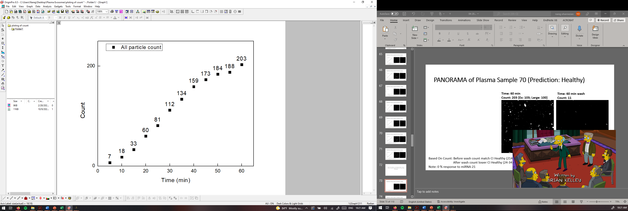
PANORAMA of Plasma Sample 70 (Prediction: Healthy)
Time: 60 min
Count: 203 (Ex: 103; Large: 100)
Time: 60 min wash
Count: 11
Based On Count: Before wash count match CI Healthy (214-263)
After wash count lower CI Healthy (24-34)
Note: 0 % response to miRNA-21
Scale bar: 10 µm

Slide 25
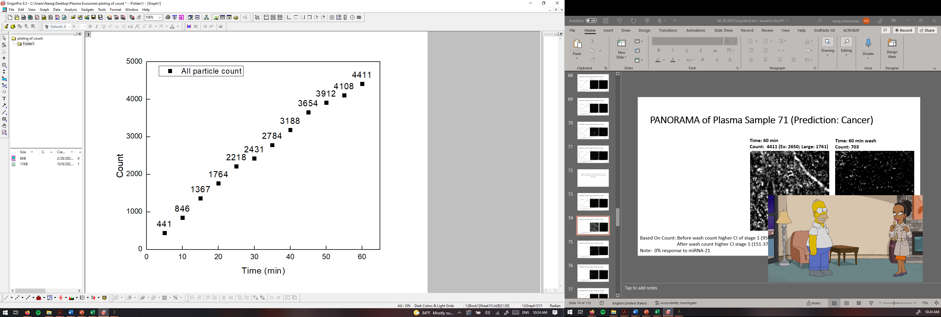
PANORAMA of Plasma Sample 71 (Prediction: Cancer)
Time: 60 min
Count: 4411 (Ex: 2650; Large: 1761)
Time: 60 min wash
Count: 703
Based On Count: Before wash count higher CI of stage 1 (950-1558)
After wash count higher CI stage 1 (151-370)
Note: 0% response to miRNA-21
Scale bar: 10 µm

Slide 26
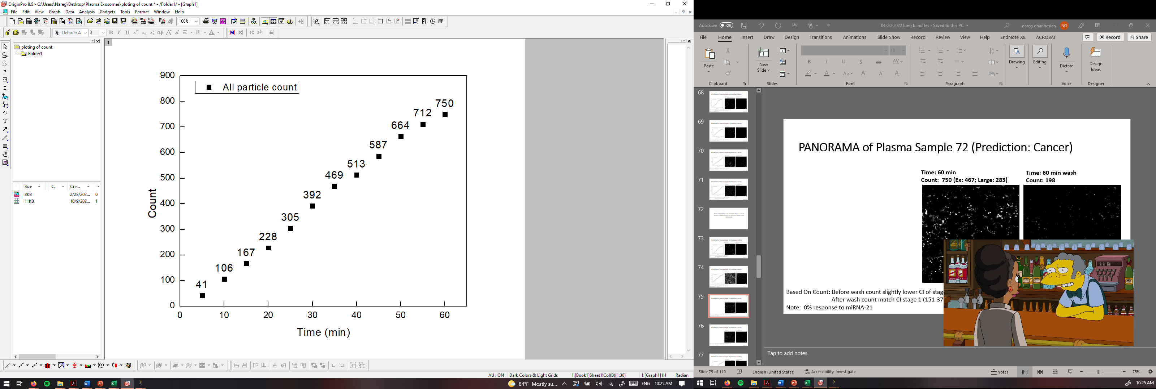
PANORAMA of Plasma Sample 72 (Prediction: Cancer)
Time: 60 min
Count: 750 (Ex: 467; Large: 283)
Time: 60 min wash
Count: 198
Based On Count: Before wash count slightly lower CI of stage 1 (950-1558)
After wash count match CI stage 1 (151-370)
Note: 0% response to miRNA-21
Scale bar: 10 µm

Slide 27
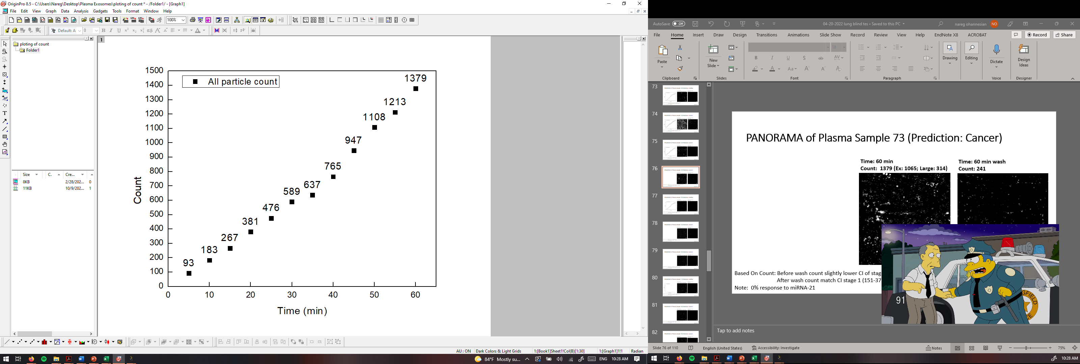

PANORAMA of Plasma Sample 73 (Prediction: Cancer)
Time: 60 min
Count: 1379 (Ex: 1065; Large: 314)
Time: 60 min wash
Count: 241
Based On Count: Before wash count slightly lower CI of stage 1 (950-1558)
After wash count match CI stage 1 (151-370)
Note: 0% response to miRNA-21
Scale bar: 10 µm

Slide 28
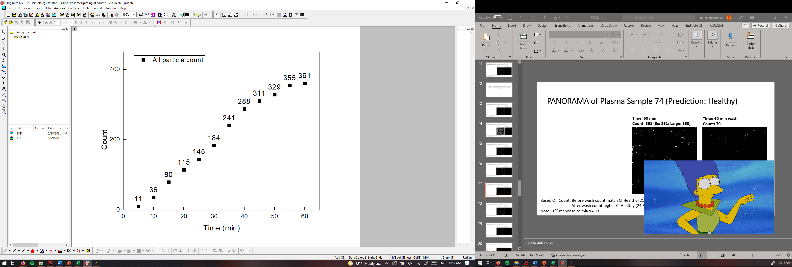

PANORAMA of Plasma Sample 74 (Prediction: Healthy)
Time: 60 min
Count: 361 (Ex: 231; Large: 130)
Time: 60 min wash
Count: 70
Based On Count: Before wash count match CI Healthy (214-263)
After wash count higher CI Healthy (24-34)
Note: 0 % response to miRNA-21
Scale bar: 10 µm

